Slide 1
The Trifeca

Slide 2
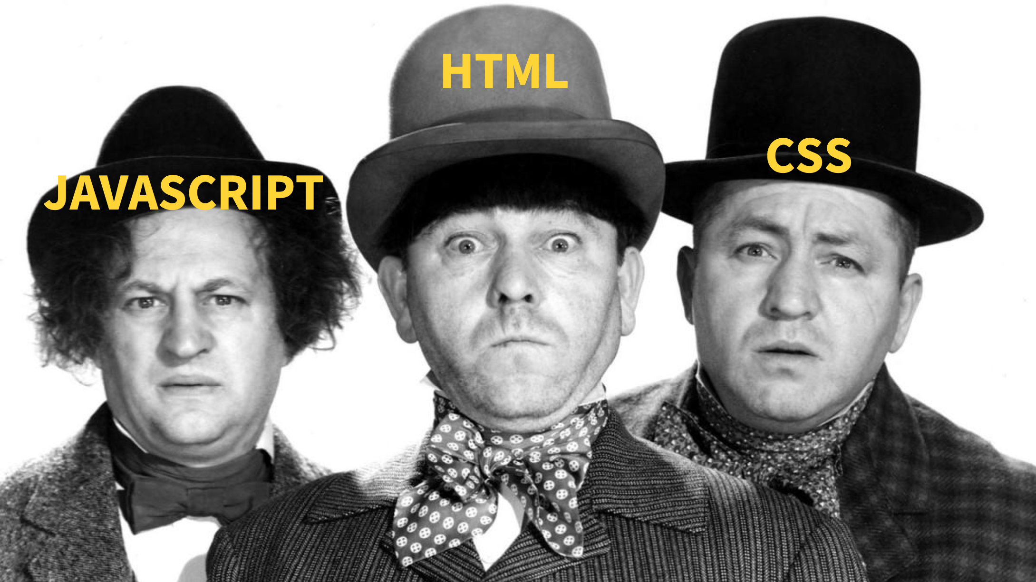

Slide 3
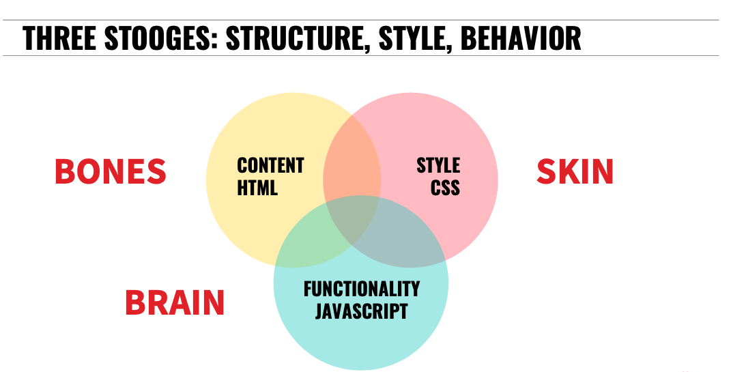

Slide 4
Learning Objectives (students will be able to...)
Explain the DOM: its value and its structure
Access DOM Elements using relative selection
Access DOM Elements using query selectors
Create, Read (access), Update (content and attributes), and Destroy DOM elements

Slide 5
Framing (10 minutes)
Why study JS?
What does "it runs in the browser" mean? Why is this something that we would want to do?
We've talked about values (primitive types and objects) and the language constructs for creating our own. We have also alluded to / used some values which are available to us in the "environment". What is an example?
What is the most annoying thing about websites?
What is HTML / a Document (in terms of the web) and how to we represent it?

Slide 6
Introducing the DOM (10 minutes)
JavaScript is the lingua franca of the web. Since it's advent in 1995 as a neat but hastily delivered browser feature from Netscape it has revolutionized the web and by extension the world. Foundational to the success (existence) of this revolution is a clunky and confusing API called the DOM, the Document Object Model. The DOM's conception was organic and as its importance grew was standardized.
NOTE: Keep in mind that the DOM is NOT just whatever is in the HTML!
The DOM is best understood through use so we will waste little time before diving in but if you are interested in a more complete / formalized description, check out CSS Tricks: What is the DOM? and MDN Intro to the DOM

Slide 7
Representing the Document
The document is the content of our webpage which is encoded into our HTML. The HTML we write is one representation of this.
What structure does HTML take? (hint: think of parent / child relationships between elements) hint 2
An HTML document (like so many other things in programming) is a tree. We will think of it as a tree of elements:

Slide 8
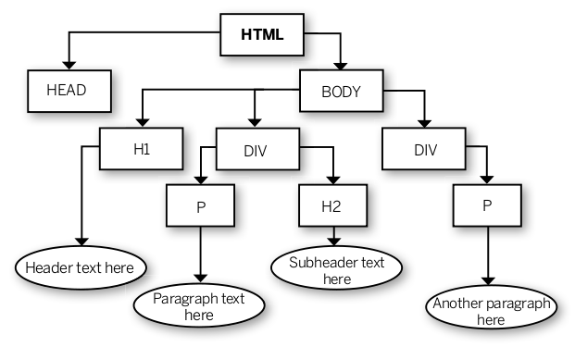

Slide 9
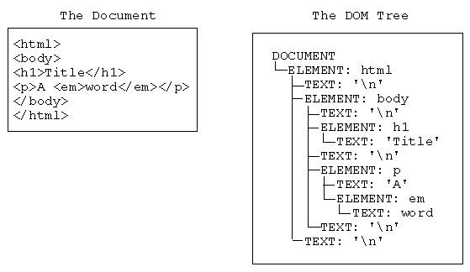
It is important to note though, that there are separate element and text nodes:

Slide 10
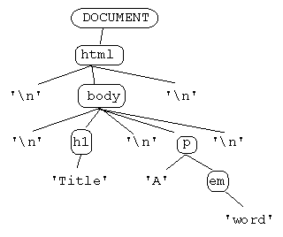
We will generally interact with elements and consider the text something belonging to the element but remember to keep in mind actual implementation

Slide 11
Query Selectors (10 minutes)
Historically the DOM's implementation has been inconsistent across browsers and many of its methods are/were lengthy. This led to the creation of a library called JQuery, which became phenomenally popular due to its ability to patch some annoying parts of JavaScript, and created many methods to assist the interaction with the DOM in the browser. JQuery helped remove lots of boilerplate browser detection schemes, where certain code was only valid in certain browsers.
read this: https://blog.garstasio.com/you-dont-need-jquery/why-not/
We're not going to dive into jQuery today. Instead, we'll be looking at more modern ways of interacting with the DOM using the free methods provided to us by the DOM.

Slide 12
Accessing Element Objects
When interacting with the DOM, we will primarily be interfacing with element object
The document object is exposed on the global object, window. This is the top level or root element object.
The document has several entry points to the page's content including .head and .body

Slide 13
Relative Selection
There are several properties that every element has which reference the elements proximate to it:
.children
.childNodes
.firstChild
.lastChild
.previousSibling
.nextSibling
.parentElement

Slide 14
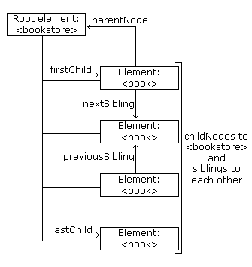

Slide 15
You DO
Spend a few minutes navigating our simple list using these properties and methods in the console. Evaluate frequently to keep you bearings and remember to use the up/down arrows to navigate your history.
Use google throughout and talk with your neighbors about confusing parts of documentation. Docs are written precisely using sometimes confusing syntax; this is necessary and a good thing but takes some getting used to

Slide 16
Query Selection
Why is relative traversal from the top level an unmaintainable approach to element selection?
Fortunately, we have some much easier method of accessing elements.
By Id
document.getElementById(id)
By Tag
document.getElementsByTagName(tagName)
By Class
document.getElementsByClassName(className)
By Selector
document.querySelector(selector) and document.querySelectorAll(selector) use CSS selectors to target elements.
What's the difference between querySelector and querySelectorAll? How does $(selector) behave?
Why would we use any of the other selectors?

Slide 17
Manipulating Element Objects
Attributes
element.getAttribute(attr) / element.setAttribute(attr, val)
Classes
element.classList
Style
element.style
Input Value
inputElement.value / inputElement.value = someValue
Content
element.innerHTML / element.innerHTML = "<p> I'm new </p>"

Slide 18
DEMO

Slide 19
Creating, Adding, Removing Elements
vanilla: document.createElement(tagName)
NOTE: this just creates elements but they are not yet on the body!
element.appendChild(newElement)
look at the docs for the js method .innerHTML. How is it different from the above method?
Why might we not really like this?
element.removeChild(childElement)

Slide 20
Intro to Events / Review (time permitting)
We've covered a lot today but we are missing one key element to creating dynamic sites.

Slide 21
Reference
MDN DOM
Eloquent JS: The Document Object Model

